Slide 1


Let’s deduce the why and how....
Chatbot Presentation
Presented by team TRIDENTS
Shuvam Swapnil Dash (Leader)
Shashwat Mandal
Kunal Bansal
App and ML Developer
ML Developer
App Developer

Slide 2



The Problem:
Developing a fully functional Agentic Chatbot system that showcases autonomous reasoning, planning, and task execution. The system should demonstrate live functionality, effective use of tools or APIs, and the ability to adapt to dynamic inputs. Explain key design decisions, highlight the chatbot’s robustness and scalability, and demonstrate its potential for real-world deployment.

Slide 3
What does the user want?

Slide 4
High Relevance & Robustness:
Delivers accurate and context-aware responses across varied queries and formats.
What does the user want?

Slide 5
High Relevance & Robustness:
Delivers accurate and context-aware responses across varied queries and formats.
What does the user want?
Real-Time Data Awareness:
Continuously updated to reflect the most recent information and trends.

Slide 6
High Relevance & Robustness:
Delivers accurate and context-aware responses across varied queries and formats.
What does the user want?
Real-Time Data Awareness:
Continuously updated to reflect the most recent information and trends.
Multi-Modal Understanding:
Capable of reading and reasoning over PDFs, documents, and images effectively.

Slide 7
How do we plan to apply?

Slide 8
Apply Adaptive Retreival and context enrichment strategy in our RAG

Slide 9
fawf
Query Classification
Dynamic Strategy Selection
Tailored Retrieval
Improved Precision
Adaptive RAG System

Slide 10
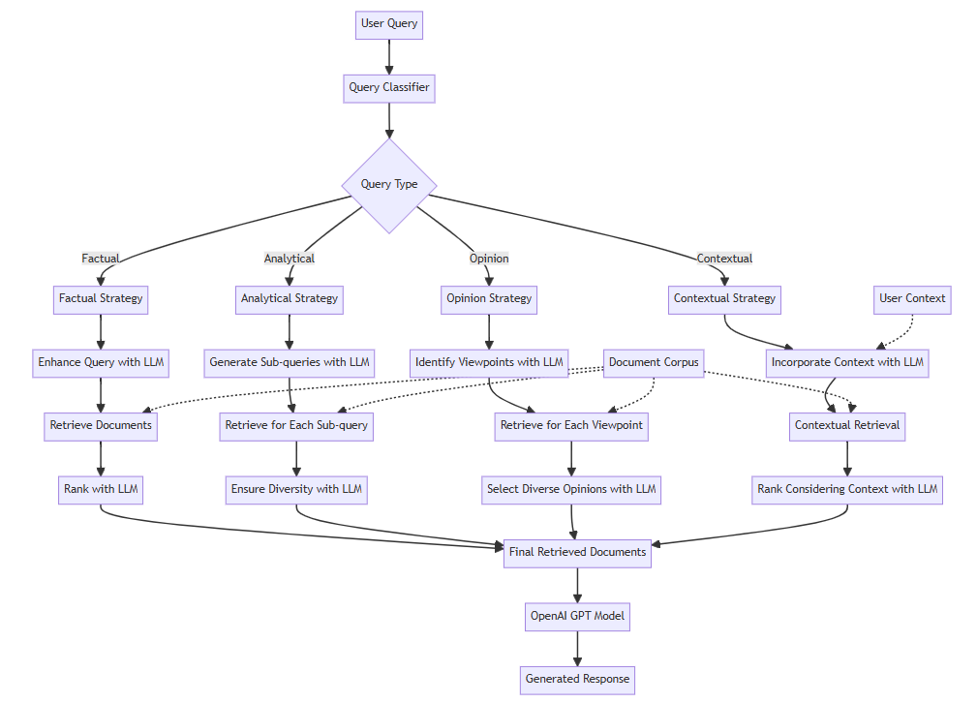
Adaptive RAG System

Slide 11
fawf
Web Scraping for Context
Semantic Chunking
Context Enrichment
Vector Embedding & Storage
Enhanced Retrieval
Context
Enrichment
Strategy

Slide 12
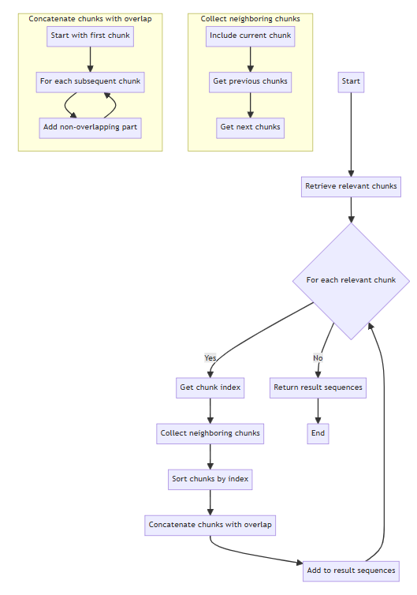
fawf
Context
enrichment
strategy

Slide 13
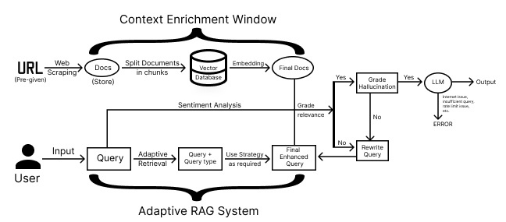
Overall Workflow

Slide 14
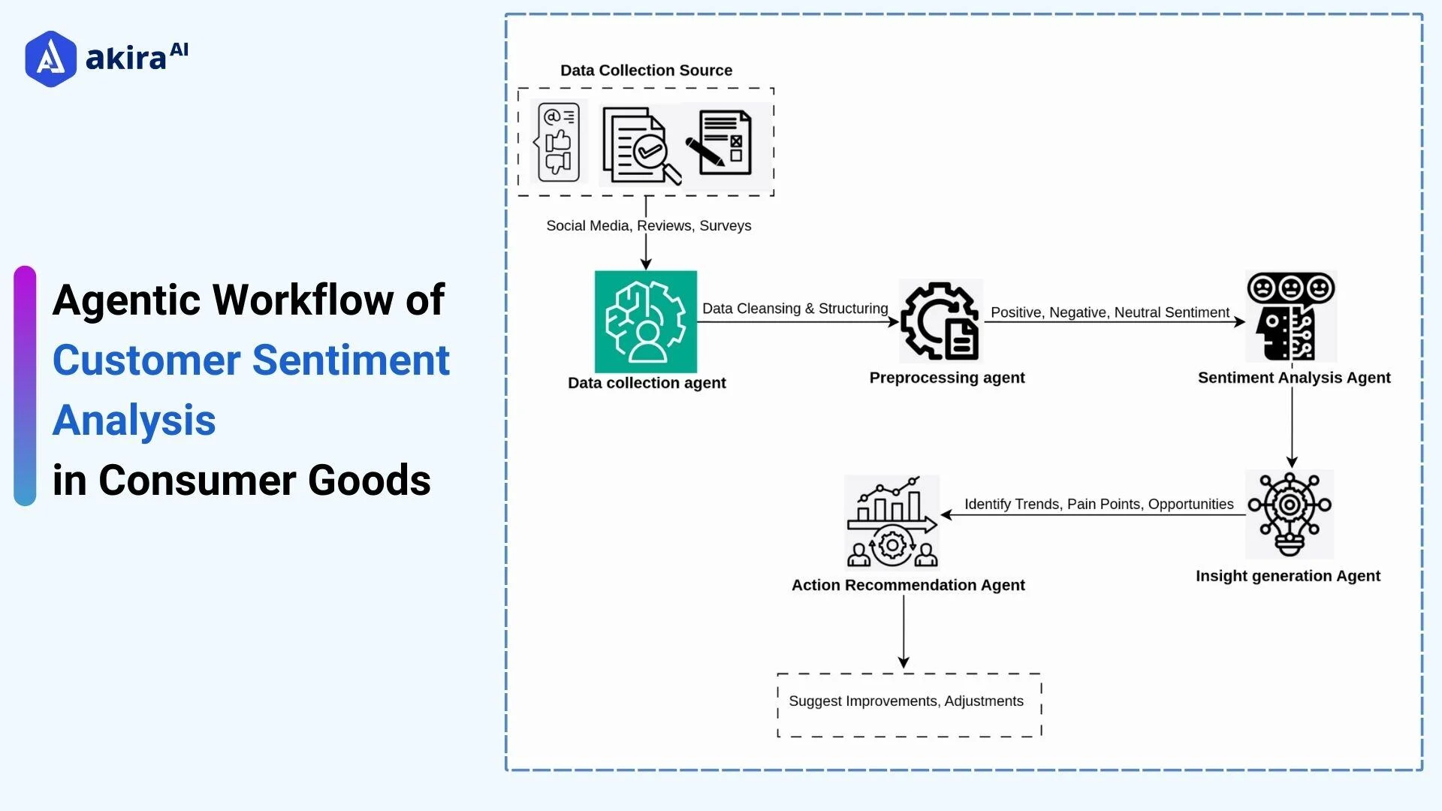
Sentiment Analysis

Slide 15

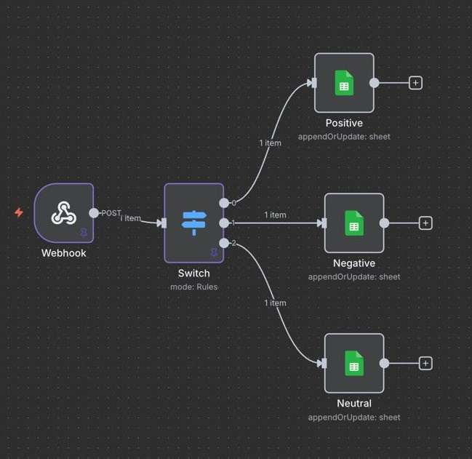
Asynchronous n8n Integration:
Our system integrates with n8n to trigger external workflows by sending data payloads asynchronously using a background thread.

Slide 16

Real time data:
We used privacy-focused search engine (duckduckgo) for real time data awareness
Context-Aware Conversational Memory:
Our platform builds a dynamic memory for each individual user session, creating a unique and persistent conversational thread.
Others
Features
MultiModal Understanding:
A MultiModalProcessor converts files into standardized text before sending them to the LLM. It detects the file type and uses specialized parsers—extracting text from documents, OCR for images, summaries for structured data, and metadata from media.
Asynchronous n8n Integration:
Our system integrates with n8n to trigger external workflows by sending data payloads asynchronously using a background thread.

Slide 17




App Integration
01
02
03
04
Begin by setting up a cross-platform Flutter app with essential packages like dio for backend communication, file_picker for capturing multimodal inputs (images, audio), and audioplayers for playing audio responses. Ensure proper platform permissions are configured for accessing the microphone, storage, and camera. The UI should include a chat interface that supports text input, optional media upload, and response playback.
Develop a Flask (or FastAPI) backend with an endpoint, such as /chat, that receives text and optional media inputs. This endpoint routes the request through a multimodal RAG pipeline to generate a contextual response.
In the Flutter app, create a POST request to the /chat endpoint, attaching user text and any selected image or audio using multipart/form-data. Upon receiving the response, extract the generated text for display in the chat and use AudioPlayer or an equivalent library to stream or play the TTS audio. This creates a seamless feedback loop between the user and the AI agent with both visual and auditory outputs.
To complete the multimodal experience, integrate voice input using Deepgram STT or a similar API, allowing users to speak instead of type. Enhance usability by automatically playing Deepgram’s TTS output when a response is received. Support real-time image or audio uploads to further enrich interaction. Optionally, track user sentiment, session data, or interaction patterns for personalization or analytics in future iterations.

Slide 18
The system ensures stability via input validation, multimodal normalization, and self-correcting logic. It refines vague queries, verifies document relevance, and rejects hallucinated answers. Robust error handling and state tracking allow graceful recovery.
Robustness
and
Scalability
Since all tools and features added work parallely with the input processing, it is easy to add more tools or cases to the system.
To ensure scalability, we used database in our n8n architecture for efficient storage of session data, logs, enabling stateful recovery and high reliability under load. The system is containerized using Docker, allowing scaling and consistent deployments.

Slide 19
Future Steps
Storing conversations as Graph
Multimodal Outputs
In agentic AI systems, storing conversations as a graph allows for dynamic and contextual memory representation where each message, action, or decision is modeled as a node, and relationships such as cause-effect, follow-up, or correction are represented as edges.
By integrating diverse output forms, the agent becomes more expressive and aligned with human communication styles. For instance, it can explain a concept visually, respond with voice for accessibility, or trigger interactive components like maps or charts.
Code Snippets/Other Markdown Features
Extension for Usage of Various Tools
Code snippets serve as dynamic and executable responses that empower the system to solve technical problems, generate tools, or automate tasks on the fly. When a user asks a programming-related question or needs a workflow automation, the AI can generate relevant code as part of its output. These snippets can include Python functions, SQL queries, or shell scripts, tailored to the user’s environment and intent.
In agentic AI, integrating automation tools like n8n allows the system to trigger real-world workflows based on conversational context. This creates a seamless bridge between natural language understanding and action execution, enabling the AI to not only reason or respond but also act through predefined automation pipelines—making interactions more powerful, goal-oriented, and operationally useful.

Slide 20

The End

